Slide 1


Stock Market Prediction
USING
MACHINE LEARNING
Akshay R 1ST14CS010
Aravind B 1ST14CS023
Arun Kumar 1ST14CS025
Ashok S 1ST14CS027
Under the guidance of
Dr. T John Peter
H.O.D, Dept. of CSE
Sambhram Institute of Technology
Department of Computer Science & Engineering

Slide 2

Stock Market Prediction
Abstract
Introduction
Implementation
Agenda
Results & Discussions
Performance Analysis
Future Enhancement
Conclusion

Slide 3

Abstract
Stock Market Prediction
Time series forecasting has been widely used to determine the future prices of stock, and the analysis and modelling of finance time series importantly guide investors’ decisions and trades
This work proposes an intelligent time series prediction system that uses sliding-window metaheuristic optimization for the purpose of predicting the stock prices
The system has a graphical user interface and functions as a stand-alone application.
The proposed model is a promising predictive technique for highly non-linear time series, whose patterns are difficult to capture by traditional models.

Slide 4

Introduction
Stock Market Prediction
Financial markets are highly volatile and generate huge amounts of data daily
It is the most popular financial market instrument and its value changes quickly
Stock prices are predicted to determine the future value of companies’ stock or other financial instruments that are marketed on financial exchanges
However, the stock market is influenced by many factors such as political events, economic conditions and traders’ expectation

Slide 5
Stock Market Prediction
Implementation
Overview
Input : Company
Fetch Data
Plot Data
Train model (LSSVR)
Predict Stock for n Days
Plot Predicted Results
Save Model

Slide 6
Stock Market Prediction
Implementation
Algorithm
Algorithm : StockPrediction
Input : COMP, D_RANGE, N_PRED [company, date range, n-day predictions]
Output : A vector of predicted prices and graph, RESULTS
data ← fetch stock for COMP in date range D_RANGE
plot(data)
train_data ← slidingWindow(data) //perform sliding window operation on data
RESULTS ← 0 //set accuracy vector to zeroes
for each day in N_PRED :
model ← LSSVM(train_data) //pass the training data to LSSVM
pred ← predict(model,day) //predict the price given model and day
remove first item from train_data //removing last item and adding predicted value
train_data ← add pred to train_data //Last In, First Out.
RESULTS ← add pred to RESULTS
end for
print(RESULTS)
plot(RESULTS)
return

Slide 7
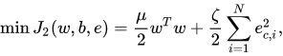
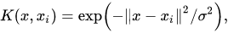

Stock Market Prediction
Implementation
LSSVR Formulation
Least Squares Support Vector Regression
The least squares version of the SVM classifier is obtained by reformulating the minimization problem as
For the kernel function K($x,x_{i}$) one typically has the Radial Basis Function
The LSSVR algorithm is a further development of SVR by Suykens (2001) and involves equality instead of inequality constraints, and works with a least squares objective function. The LSSVR approach considerably reduces computational complexity and increases efficiency compared to standard SVM. LSSVR solves linear equations instead of a quadratic programming problem

Slide 8
Stock Market Prediction
Implementation
Sliding-Window
Algorithm : slidingWindow
Input : data [stock data]
Output : A data frame of a lagged stock data
LAG ← 1
y ← remove first LAG rows from data
reset row indices of y
x ← remove last LAG rows from data
train ← merge (x,y) into a dataframe
rename column name to x and y
return train
slidingWindow = function(data)
{
y = data[-(1:LAG),]
rownames(y) = NULL
x= data[1:(DATA_SIZE-LAG),]
train = data.frame(x[,2],y[,2])
colnames(train) = c("x","y")
return(train)
}

Slide 9
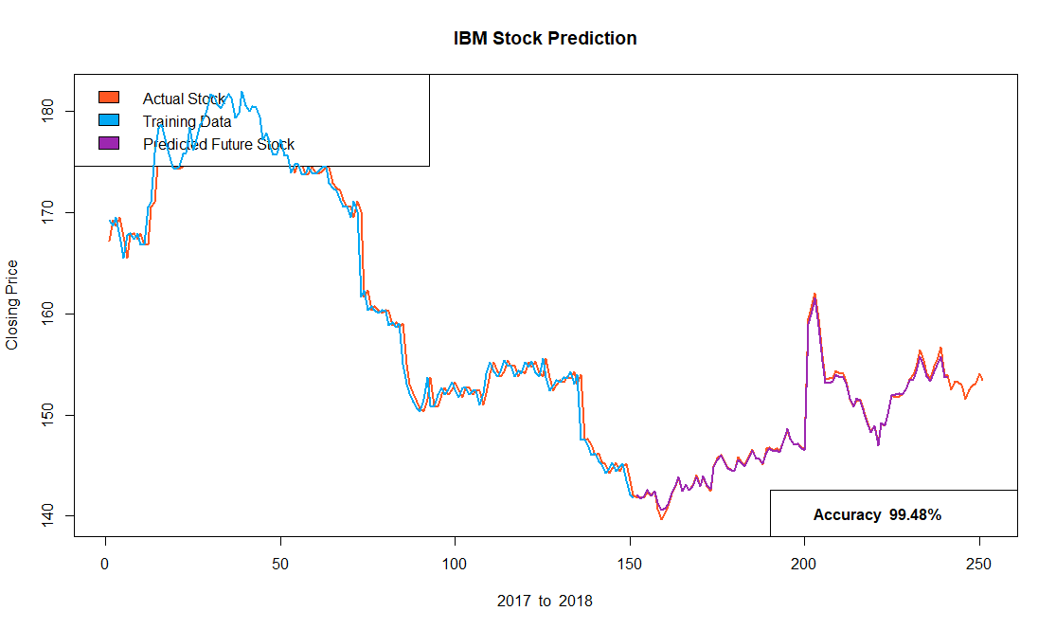
Results & Discussions
Stock Market Prediction

Slide 10
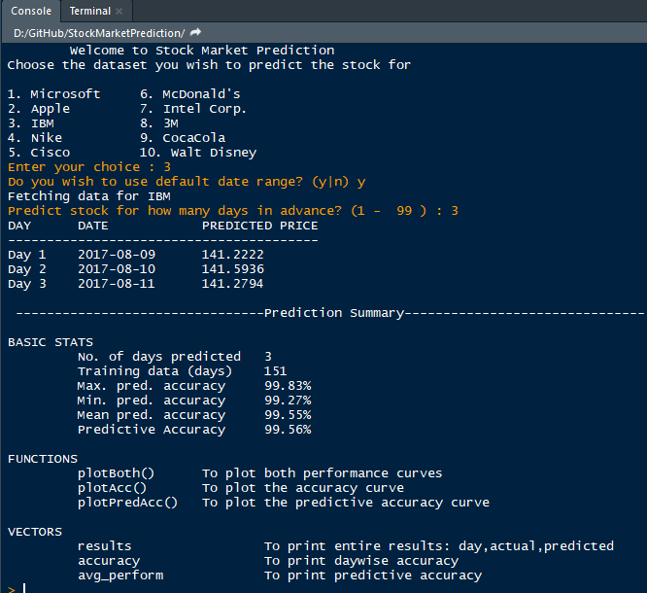
Stock Market Prediction
Snapshot

Slide 11
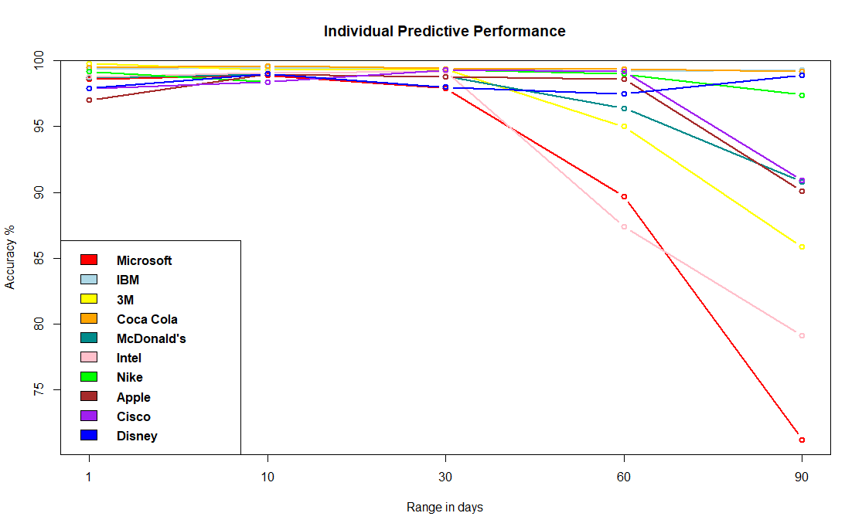
Performance
Stock Market Prediction

Slide 12
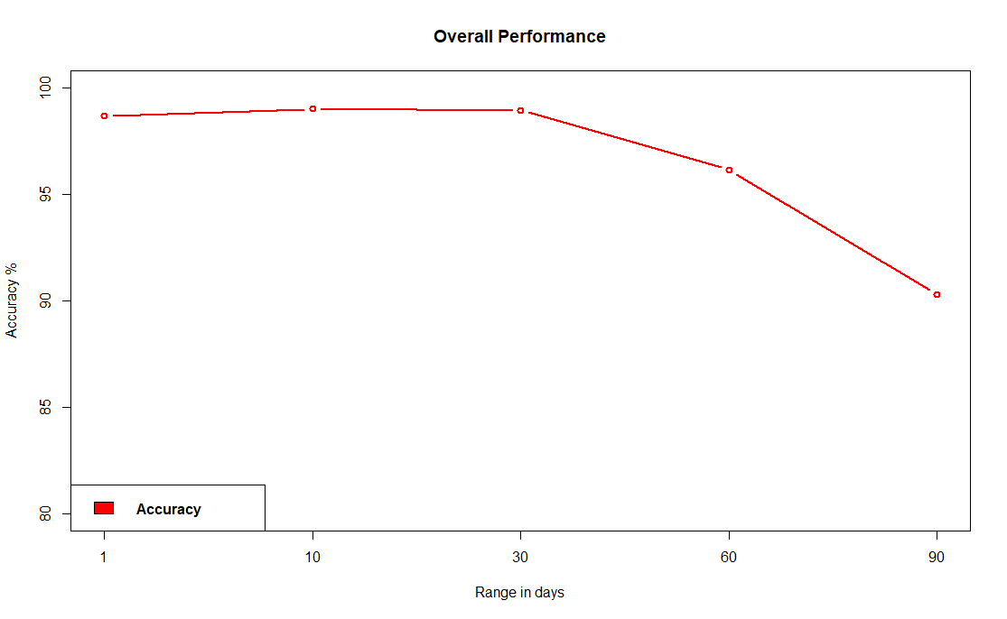
Performance
Stock Market Prediction

Slide 13

Stock Market Prediction
Future Enhancement
Limitations :
The limitation of the proposed system is its computational speed, especially with respect to sliding-window validation as the computational cost increases with the number of forward day predictions.
Future Enhancement :
The proposed model does not predict well for sudden changes in the trend of stock data.
This occurs due to external factors and real-world changes affecting the stock market.
We can overcome this by implementing Sentiment Analysis and Neural Networks to enhance the proposed model.
We can modify the same system to an online-learning system that adapts in real-time.

Slide 14
Stock Market Prediction
Conclusion
Thus, as we can see above in our proposed method, we train the data using existing stock dataset that is available. We use this data to predict and forecast the stock price of n-days into the future.
The average performance of the model decreases with increase in number of days, due to unpredictable changes in trend.
The current system can update its training set as each day passes so as to detect newer trends and behave like an online-learning system that predicts stock in real-time.

Slide 15
Stock Market Prediction
Thank You

